Slide 1
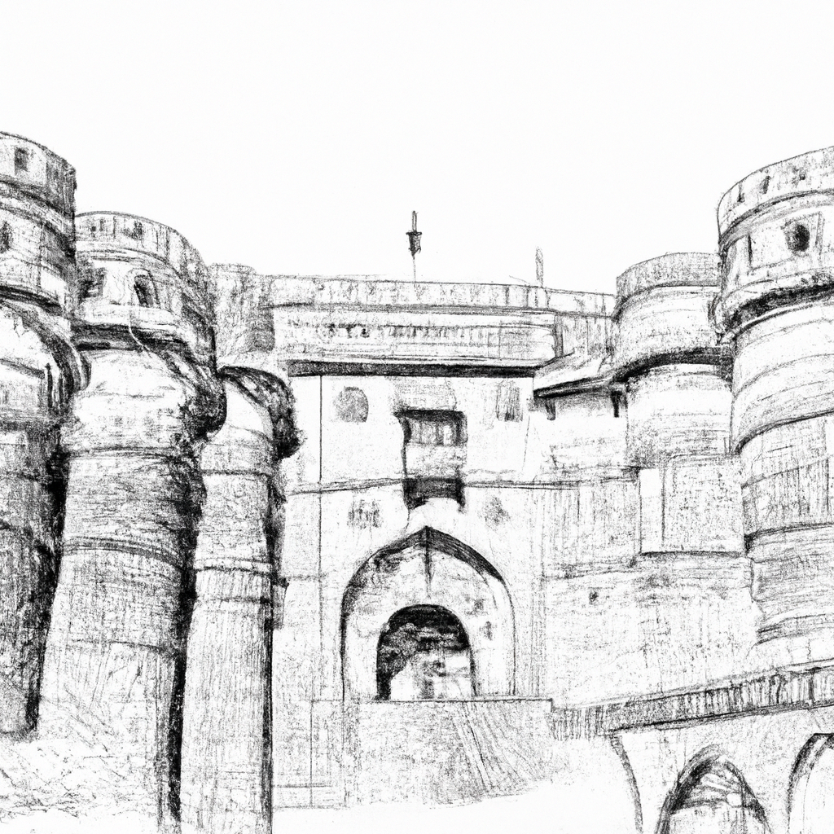
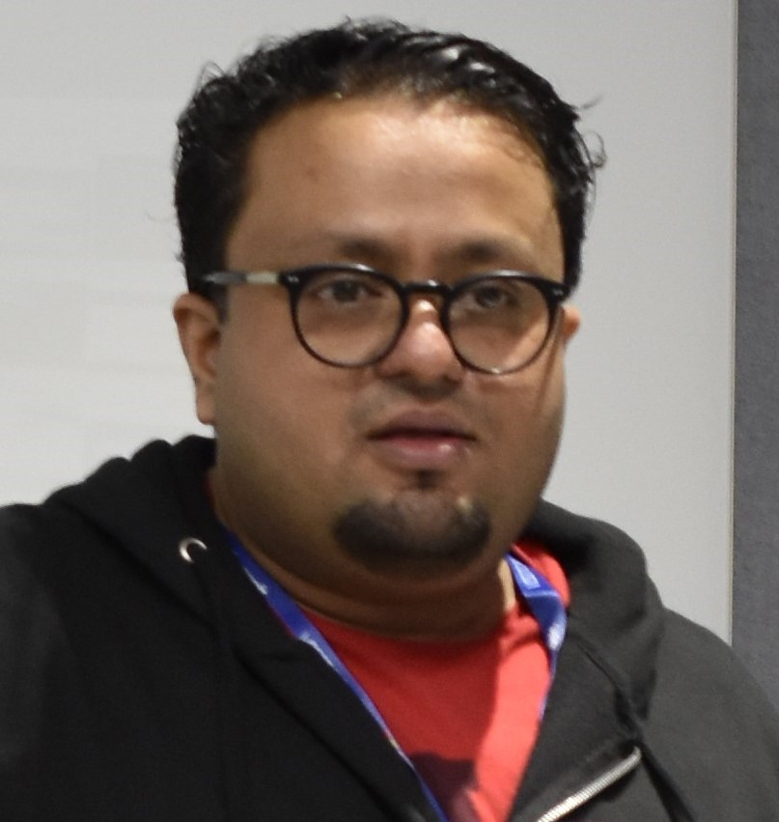
Testing the Untestable using M365 Developer Proxy
Arjun Menon
Microsoft MVP, Solution Architect

Slide 2


Massive Thanks to Our Supporters!
Organized by
Pune Tech
Community

Slide 3

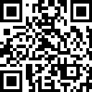

Arjun Menon
Microsoft MVP
Co-maintainer – CLI for Microsoft 365, Core Member – PnP Team
/in/arjunumenon
arjunumenon
arjunumenon.com

Slide 9
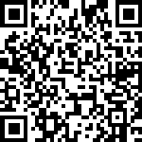
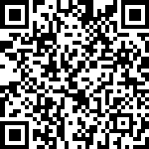
References
Item | QR | Link
Demo Artefacts |  | https://a-um.me/pune2024-repo
References / Links |  | https://a-um.me/pune2024-reference

Slide 10
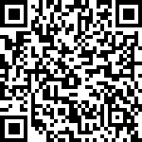
Feedback ❤️
https://a-um.me/pune2024-feedback

